Slide 1
Huffman Code & Heaps
Data Structure: Chapter 9
Min Chen
School of Computer Science and Engineering
Seoul National University

Slide 2
Content
Huffman Code
Fixed Length Coding and Variable Length Coding
Principle of Huffman Coding
Huffman Tree
Definition of Heaps
Complete Binary Heap

Slide 3
Huffman Code
Fixed Length Coding and Variable Length Coding
Decoding
Fixed Length: 010100000011001101011000
a3 a5 a1 a4 a2 a6 a4 a1
Variable Length: 0001001000101111001010
a3 a5 a1 a4 a2 a6 a4 a1
Symbols | Fixed Length | Variable Length
a1 | 000 | 010
a2 | 001 | 011
a3 | 010 | 000
a4 | 011 | 001
a5 | 100 | 10
a6 | 101 | 11

Slide 4
Principle of Huffman Code
Prefix-Free
None of the code words are the refix of other code words
Not Prefix Free Example:
a1 01
a2 011
…
011011011 a1…
011011011 a2…

Slide 5
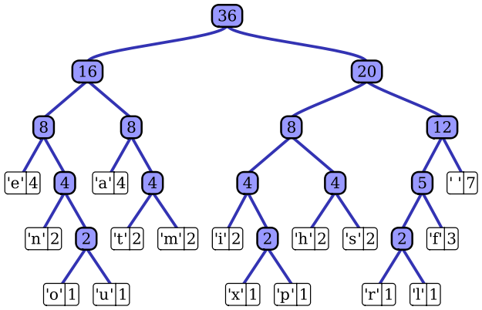
How to generate better code?
Huffman code introduce a Huffman tree
Char | Freq | Code
space | 7 | 111
a | 4 | 010
e | 4 | 000
f | 3 | 1101
h | 2 | 1010
i | 2 | 1000
m | 2 | 0111
n | 2 | 0010
s | 2 | 1011
t | 2 | 0110
l | 1 | 11001
o | 1 | 00110
p | 1 | 10011
r | 1 | 11000
u | 1 | 00111
x | 1 | 10010
0
1
0
1
0
1
0
1
0
1
0
1
0
1
0
1
0
1
0
1
0
1
0
1
0
1
0
1
0
1

Slide 6
Huffman Code
Generate Huffman Tree from bottom to top
Calculate minimum subtree
Incursive process until all nodes are added
Generate Huffman Code from top to bottom
To achieve Prefix Free

Slide 7
Definition of Heaps
A heap is a specialized tree that satisfies the heap property:
if B is a child node of A, then key(A) ≥ key(B).
This implies that an element with the greatest key is always in the root node, and so such a heap is sometimes called a max-heap.
Alternatively, if the comparison is reversed, the smallest element is always in the root node, which results in a min-heap.

Slide 8
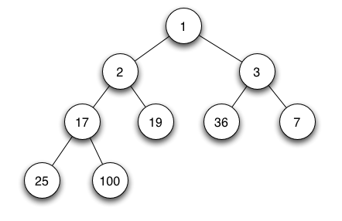
Complete Binary Min-Heap
The shape property: the tree is a complete binary tree
The heap property: each node is smaller than or equal(for min-heap) to each of its children
Fig 1.a complete binary min heap
Notes:
Complete binary tree: all levels of the tree, except possibly the last one (deepest) are fully filled, and, if the last level of the tree is not complete, the nodes of that level are filled from left to right.

Slide 9
Realization of Complete Binary Heaps
Often stored as arrays of entries by level-order traversal of the tree
2
5
3
9
6
11
4
17
10
8
X | 2 | 5 | 3 | 9 | 6 | 11 | 4 | 17 | 10 | 8

Slide 10
Insertion of Complete Binary Min-Heap
Add the value 1
1
2
2
5
1
3
9
6
1
5
11
4
17
10
8
1
6

Slide 11
Running Time Comparison
 | Binary Heap | Sorted List | Unsorted List
min() | O(1) | O(1) | O(n)
Insert()
Worst-case | O(log n) | O(n) | O(1)
Best-case | O(1) | O(1) | O(1)
removeMin()
Worst-case | O(log n) | O(1) | O(n)
Best-case | O(1) | O(1) | O(n)

Slide 12
Thank you!

